Slide 1
Chapter 1.3.2
Advanced Macro Facilities
1

Slide 2
Advanced Macro Facilities
Advanced Macro Facilities
1Conditional Macro Expansion
2. Expansion Time Loops
3. Semantic Expansion
4. Expansion Time Variable
5. (AIF)
AIF( (EXP) <SEQ. >
6. AGO
AGO <SEQ. >

Slide 3
Advanced Macro Facilities
Conditional Macro Expansion (AIF)
AIF( (EXP) <SEQ. >
2. Expansion Time Loops
AGO
AGO <SEQ. >
3. Expansion Time Variable
Source
XYZ MACRO &N
MORE MOVEM R1, 1X
&M SET &N
AIF (&M NE 1) MORE
MEND

Slide 4
Conditional Macro Expansion
Most macro processors can also modify the sequence of statements generated for a macro expansion, depending on the arguments supplied in the macro invocation.
This is called conditional macro expansion.
Figure shows the use of one type of conditional macro expansion statement.

Slide 5
Conditional Macro Expansion
Figure shows a definition of a macro RDBUFF.
Two additional parameters are defined in RDBUFF:
&EOR, which specifies a hexadecimal character code that marks the end of a record,
and &MAXLTH, which specifies the maximum length record that can be read.

Slide 6
Conditional Macro Expansion
Figure shows a definition of a macro RDBUFF.
Two additional parameters are defined in RDBUFF:
&EOR, which specifies a hexadecimal character code that marks the end of a record,
and &MAXLTH, which specifies the maximum length record that can be read.

Slide 7
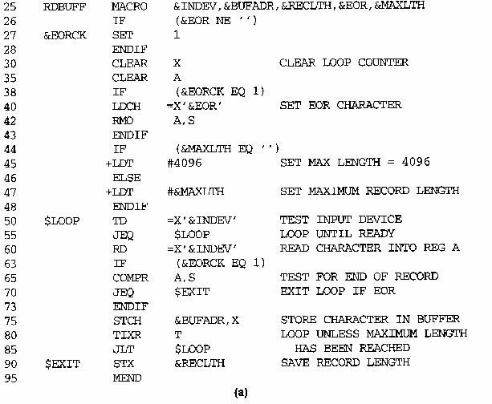

Slide 8
Conditional Macro Expansion
1st illustration: The statements on lines 44 through 48 of this definition illustrate a simple macro-time conditional structure.
The IF statement evaluates a Boolean expression that is its operand (In this case, it is [&MAXLTH EQ ‘ ‘].).
If TRUE, the statements following the IF are generated until an ELSE is encountered (Line 45 is generated.).
If FALSE, these statements are skipped, and the statements following the ELSE are generated (Line 47 is generated.).
The ENDIF statement terminates the conditional expression that was begun by the IF statement.

Slide 10
Conditional Macro Expansion
2nd illustration:
On line 26 through 28, line 27 is another macro processor directive (SET).
This SET statement assigns the value 1 to &EORCK.
The symbol &EORCK is a macro time variable, which can be used to store working values during the macro expansion.
Note any symbol that begins with the character & and that is not a macro instruction parameter is assumed to be a macro-time variable.
All such variables are initialized to a value of 0.
Other illustrations: On line 38 through 43 and line 63 through 73.

Slide 11
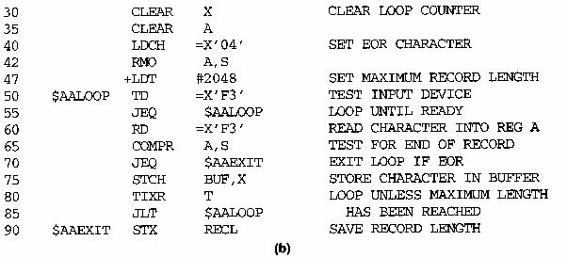
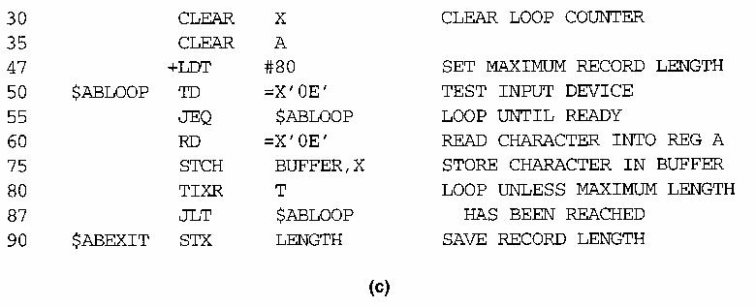
RDBUFF F3, BUF, RECL, 04, 2048
RDBUFF 0E, BUFFER, LENGTH, , 80

Slide 12
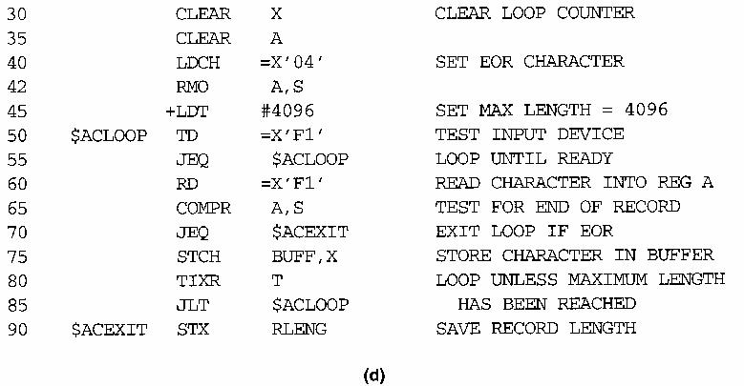
RDBUFF F1, BUFF, RLENG, 04

Slide 13
Conditional Macro Expansion
Fig (b-d) shows the expansion of 3 different macro invocation statements that illustrate the operation of the IF statements in Fig (a).
Note that the macro processor must maintain a symbol table that contains the values of all macro-time variables used.
Entries in this table are made or modified when SET statements are processed.
The table is used to look up the current value of a macro-time variable whenever it is required.

Slide 14
Conditional Macro Expansion
Syntax 1 –
IF (Boolean Exp.) (statements)
ELSE (statements)
ENDIF
If IF statement is encountered during the expansion of a macro, the specified Boolean expression is evaluated
If TRUE, the macro processor continues to process lines from DEFTAB until it encounters the next ELSE or ENDIF statement. If an ELSE is found, the macro processor then skips lines in DEFTAB until the next ENDIF. Upon reaching the ENDIF, it resumes expanding the macro in the usual way.

Slide 15
Conditional Macro Expansion
Syntax 1 –
IF (Boolean Exp.) (statements)
ELSE (statements)
ENDIF
If IF statement is encountered during the expansion of a macro, the specified Boolean expression is evaluated
If TRUE, the macro processor continues to process lines from DEFTAB until it encounters the next ELSE or ENDIF statement. If an ELSE is found, the macro processor then skips lines in DEFTAB until the next ENDIF. Upon reaching the ENDIF, it resumes expanding the macro in the usual way.
If FALSE, the macro processor skips ahead in DEFTAB until it finds the next ELSE or ENDIF statement. The macro processor then resumes normal macro expansion.

Slide 16
Conditional Macro Expansion
The implementation outlined above does not allow for nested IF structures.
It is extremely important to understand that the testing of Boolean expressions in IF statements occurs at the time macros are expanded.
By the time the program is assembled, all such decisions (must) have been made.

Slide 17
Conditional Macro Expansion
Fig 4.9 shows the use of macro-time loop statements. The definition in Fig 4.9(a) uses a macro-time loop statement WHILE.

Slide 18
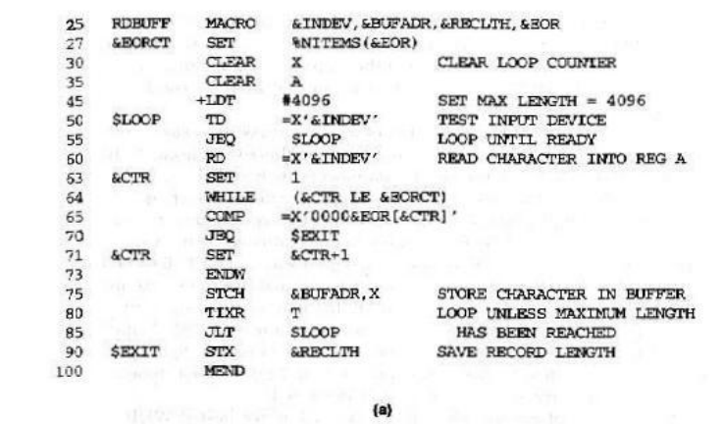

Slide 19
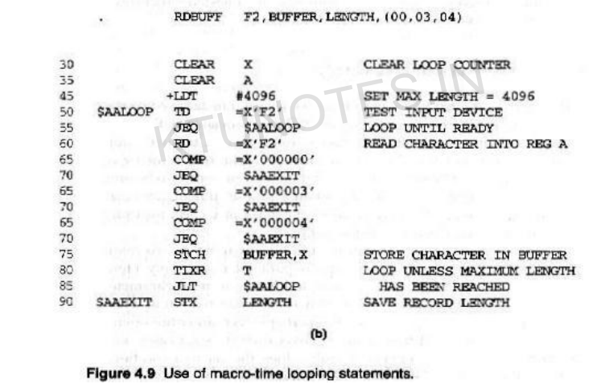

Slide 20
Conditional Macro Expansion
The WHILE statement specifies that the following lines, until the next ENDW statement, are to be generated repeatedly as long as a particular condition is true.
Note that all the generation is done at the macro expansion time.
The conditions to be tested involve macro-time variables and arguments, not run-time data values.

Slide 21
Conditional Macro Expansion
The use of the WHILE-ENDW structure is illustrated on lines 63 through 73 of Fig 4.9(a).
The macro-time variables &EORCT has previously been set (line 27) to the value %NITEMS(&EOR).
%NITEMS is a macro processor function that returns as its value the number of members in an argument list.
For example, if the argument corresponding to &EOR is (00, 03, 04), then %NITEMS(&EOR) has the value 3.
The macro-time variable &CTR is used to count the number of times the lines following the WHILE statement have been generated. The value of &CTR is initialized to 1 (line 63), and incremented by 1 each time through the loop (line 71).

Slide 22
Conditional Macro Expansion
Macro-time conditional statements
Example: Figure 4.8
IF-ELSE-ENDIF
Macro-time variables
any symbol that begins with the character & and that is not a macro parameter
macro-time variables are initialized to 0
macro-time variables can be changed with their values using SET
&EORCK SET 1

Slide 23
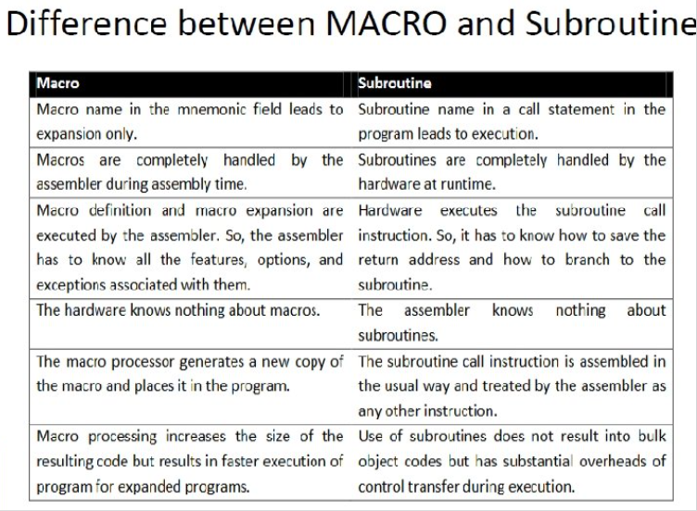

Slide 24
Conditional Macro Expansion
Types of Macro Expansion
1. Lexical Expansion
2. Semiantic Expansion
1. Lexical Expansion: Character string is replaced by another character string in the generation of program. All formal parameter is replaced by actual parameter.
2. Semiantic Expansion : Instruction as per requirement of specific usage are generated.

Slide 25
Expansion Time Loops
Macro-time conditional statements
Example: Figure 4.8
IF-ELSE-ENDIF
Macro-time variables
any symbol that begins with the character & and that is not a macro parameter
macro-time variables are initialized to 0
macro-time variables can be changed with their values using SET
&EORCK SET 1

Slide 26
Macro-Assembler
Advantage
reduce 1 pass
share same data structure
Disadvantage
more complex

Slide 27
Pass 1
READ
Search
(Pseudo-Op Table)
Pass 2
R
Type?
Search NAMTAB
(Macro Name Table)
MACRO
Define
Process
pseudo-ops
Search
(Machine Op Table)
R
R
MACRO
Expand
Process machine instruction
R
R

